Slide 1

Psalm 51
THE RHYTHM OF REPENTANCE

Slide 2
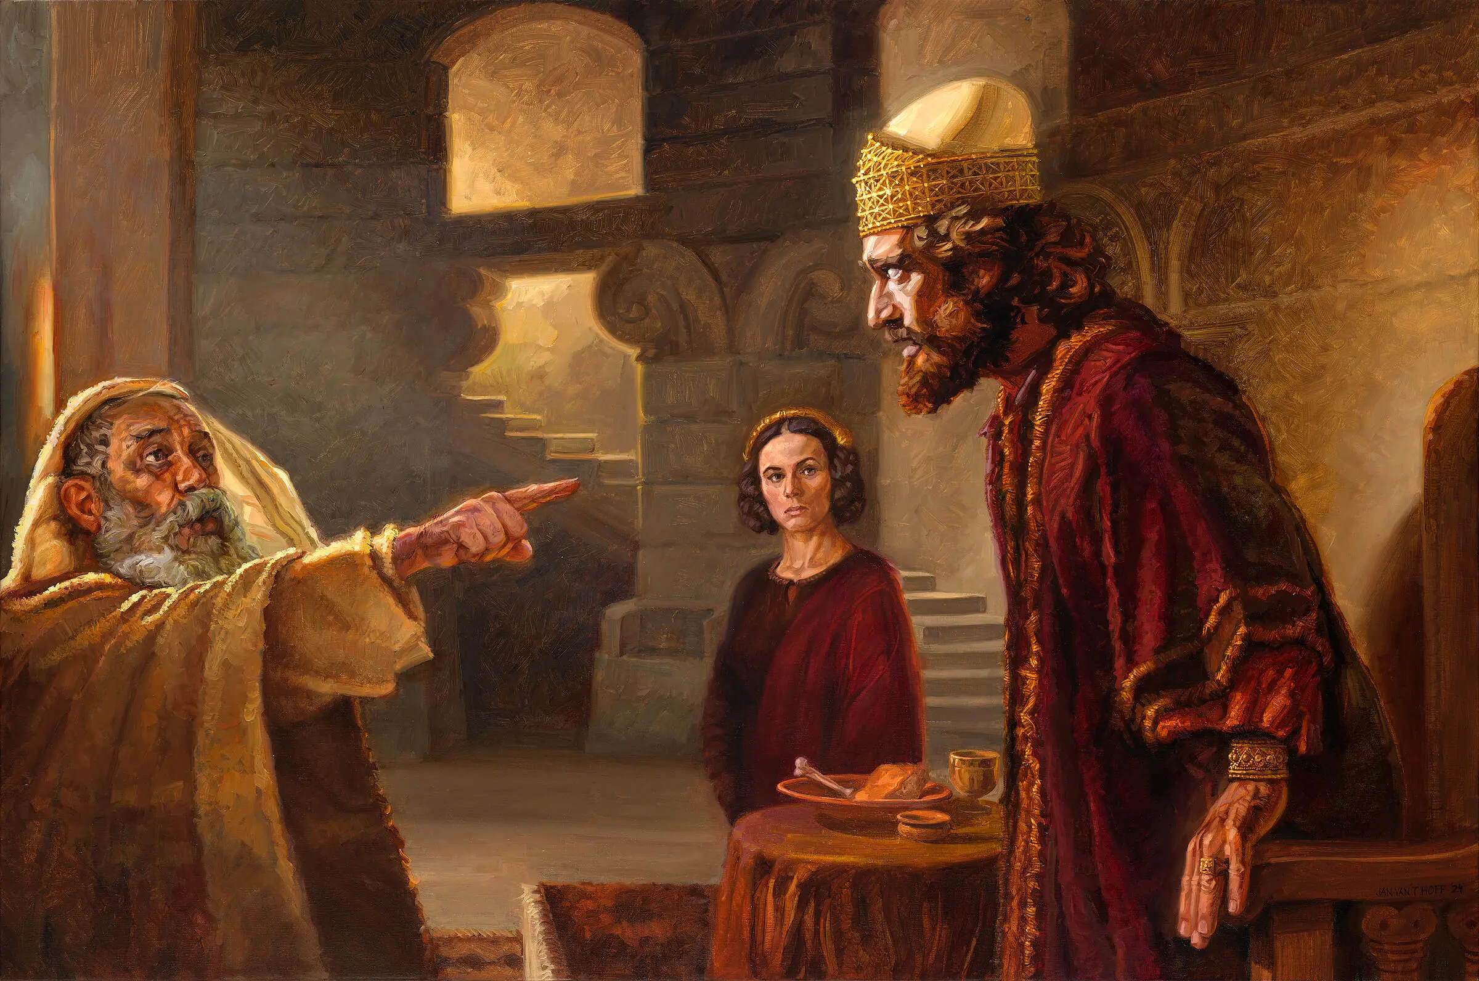

Slide 3
The Rhythm of Repentance
I AM GUILTY (1-9)

Slide 4
The Rhythm of Repentance
I AM GUILTY (1-9)
2. FORGIVE ME (1-9)

Slide 5
2. Forgive Me
DAVID TRUSTED…
GOD’S WORD

Slide 6
Exodus 34:6-7
The Lord—the Lord is a compassionate and gracious God, slow to anger and abounding in faithful love and truth, maintaining faithful love to a thousand generations, forgiving iniquity, rebellion, and sin.

Slide 7
2. Forgive Me
DAVID TRUSTED…
GOD’S WORD
B. DAVID TRUSTED…
GOD’S SACRIFICE

Slide 8
The Rhythm of Repentance
I AM GUILTY (1-9)
2. FORGIVE ME (1-9)
3. FIX ME (10-19)

