Slide 1

1 Thessalonians
A Gospel Church | From First Till Last

Slide 2
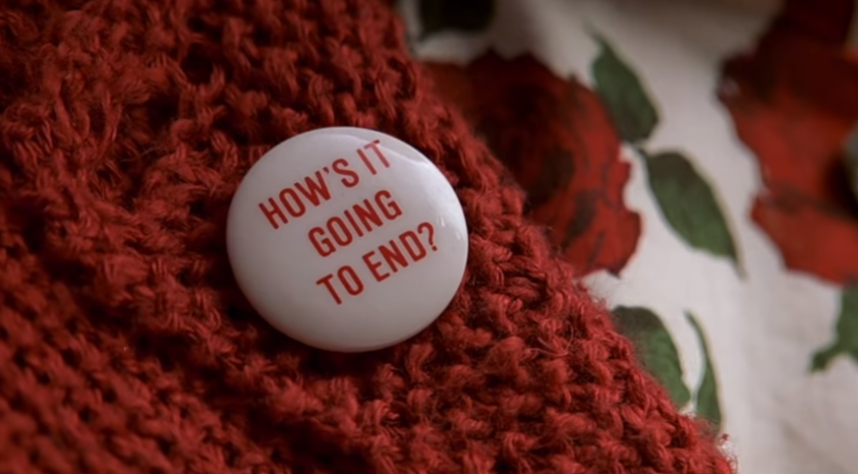
1 Thessalonians
1 Thessalonians

Slide 3
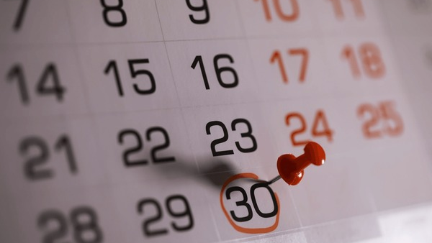
1 Thessalonians
1 Thessalonians

Slide 4
1 Thessalonians
1 Thessalonians
5:1-11 | Page 1048

Slide 5
When Will Jesus
Return?
Page 1048
5.1-11

Slide 6

He will Come Like A Thief In The Night
Sudden, Unexpected, Inescapable Judgment.
Rude awakening is coming when this sobering dawn breaks
Page 1048
5.1-11

Slide 7
But it is Not like that for the children of Light
Page 1048
5.1-11

Slide 8
For The Children of Light
Sudden, Expected, Certain Salvation
Christ’s Light has dawned on us, so we are up & dressed, soberly waiting for His return
Page 1048
5.1-11

Slide 9
“ Therefore encourage one another and build each other up as you are already doing.”
Page 1048
5.11

