Slide 1


Slide 2
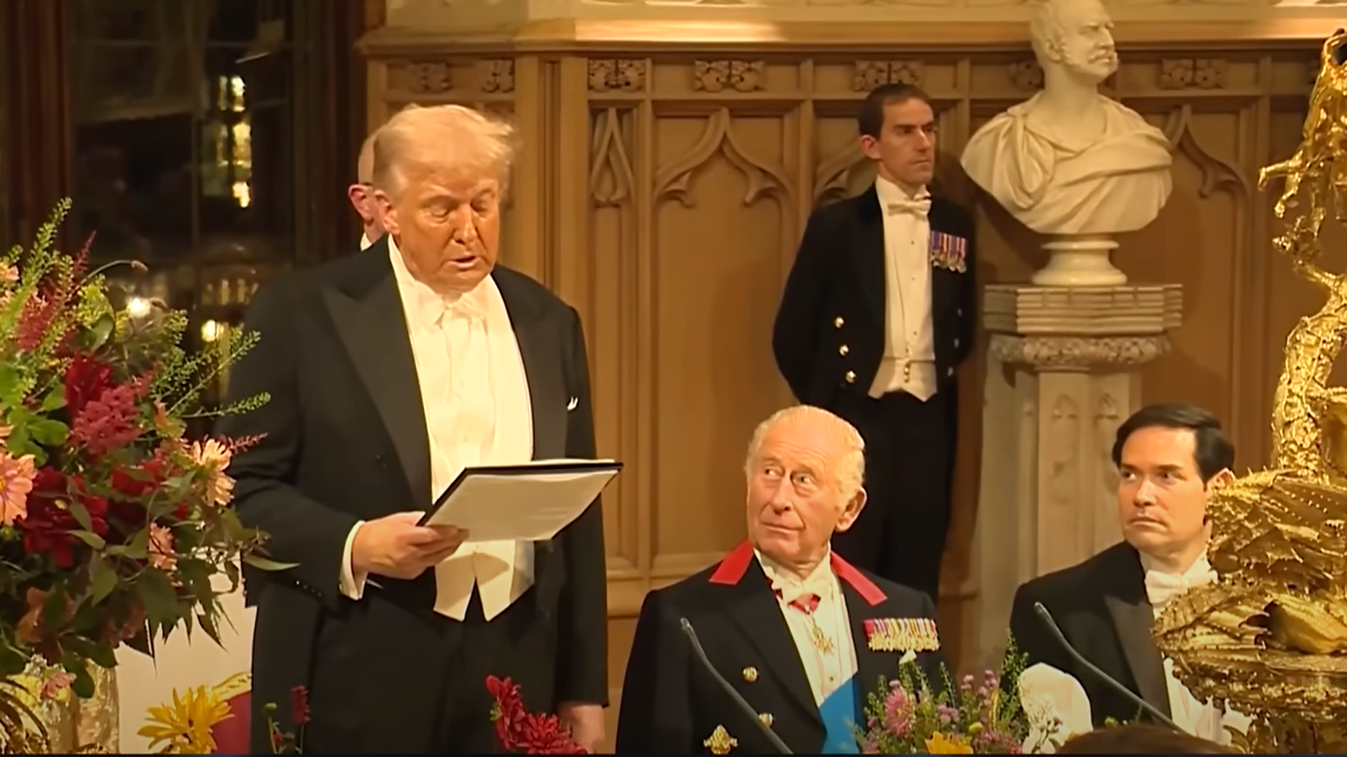

Slide 3

1 Samuel 18-19
Page 249-251

Slide 4

The Victorious King

Slide 5
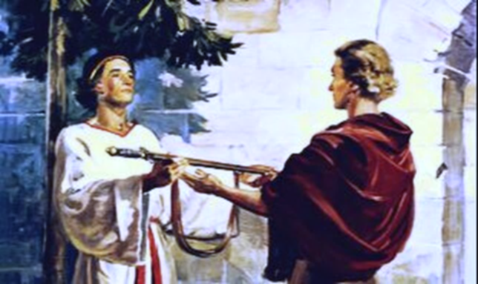
Love and Loyalty

Slide 6
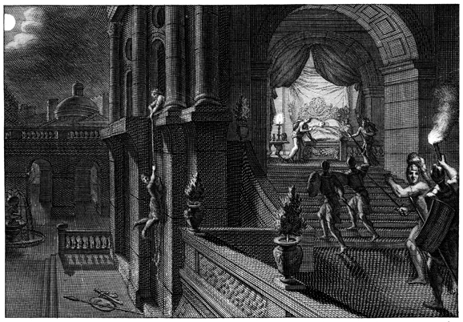
Love and Loyalty

Slide 7
Love and Loyalty

Slide 8
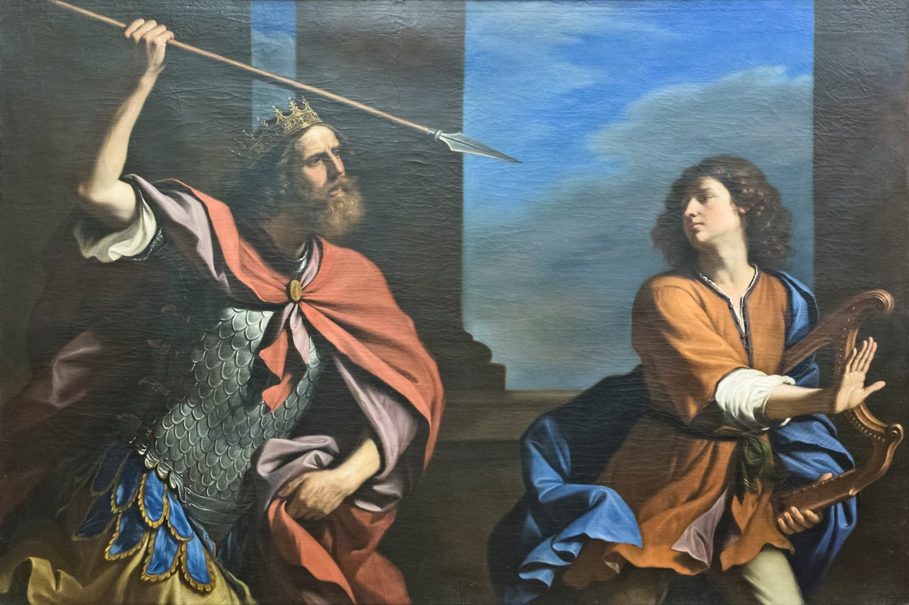
Hate and Hostility

Slide 9
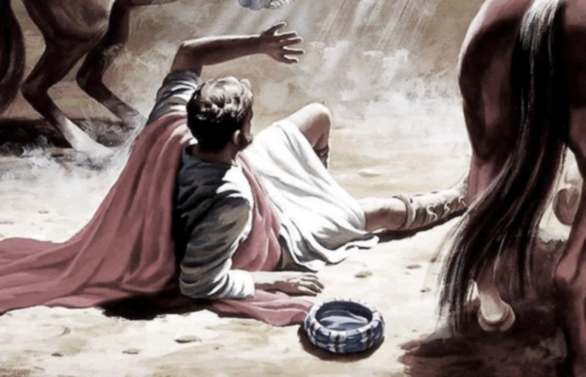
Another Saul
Stopped

Slide 10
“Pay Homage to
God’s Royal son”

