Slide 1


Slide 2

1 Samuel 17.1-58
Page 249

Slide 3
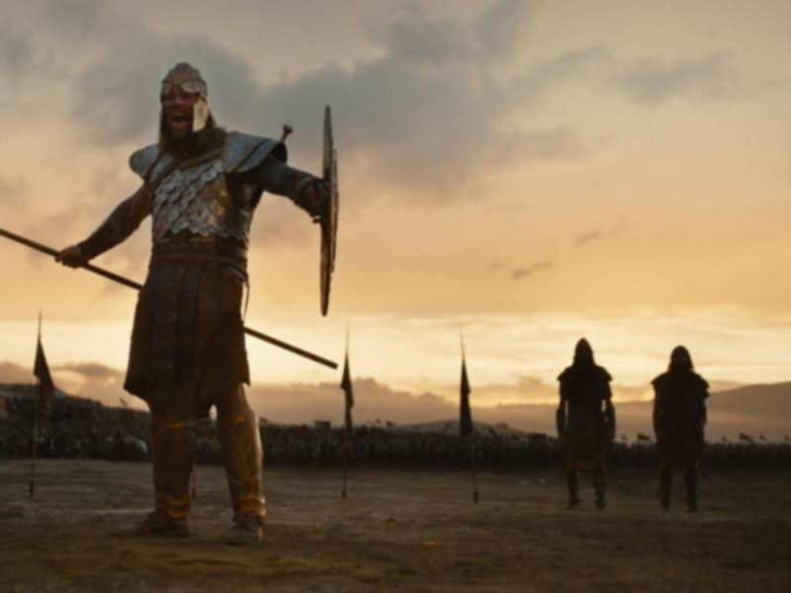
The Big Bad Enemy

Slide 4
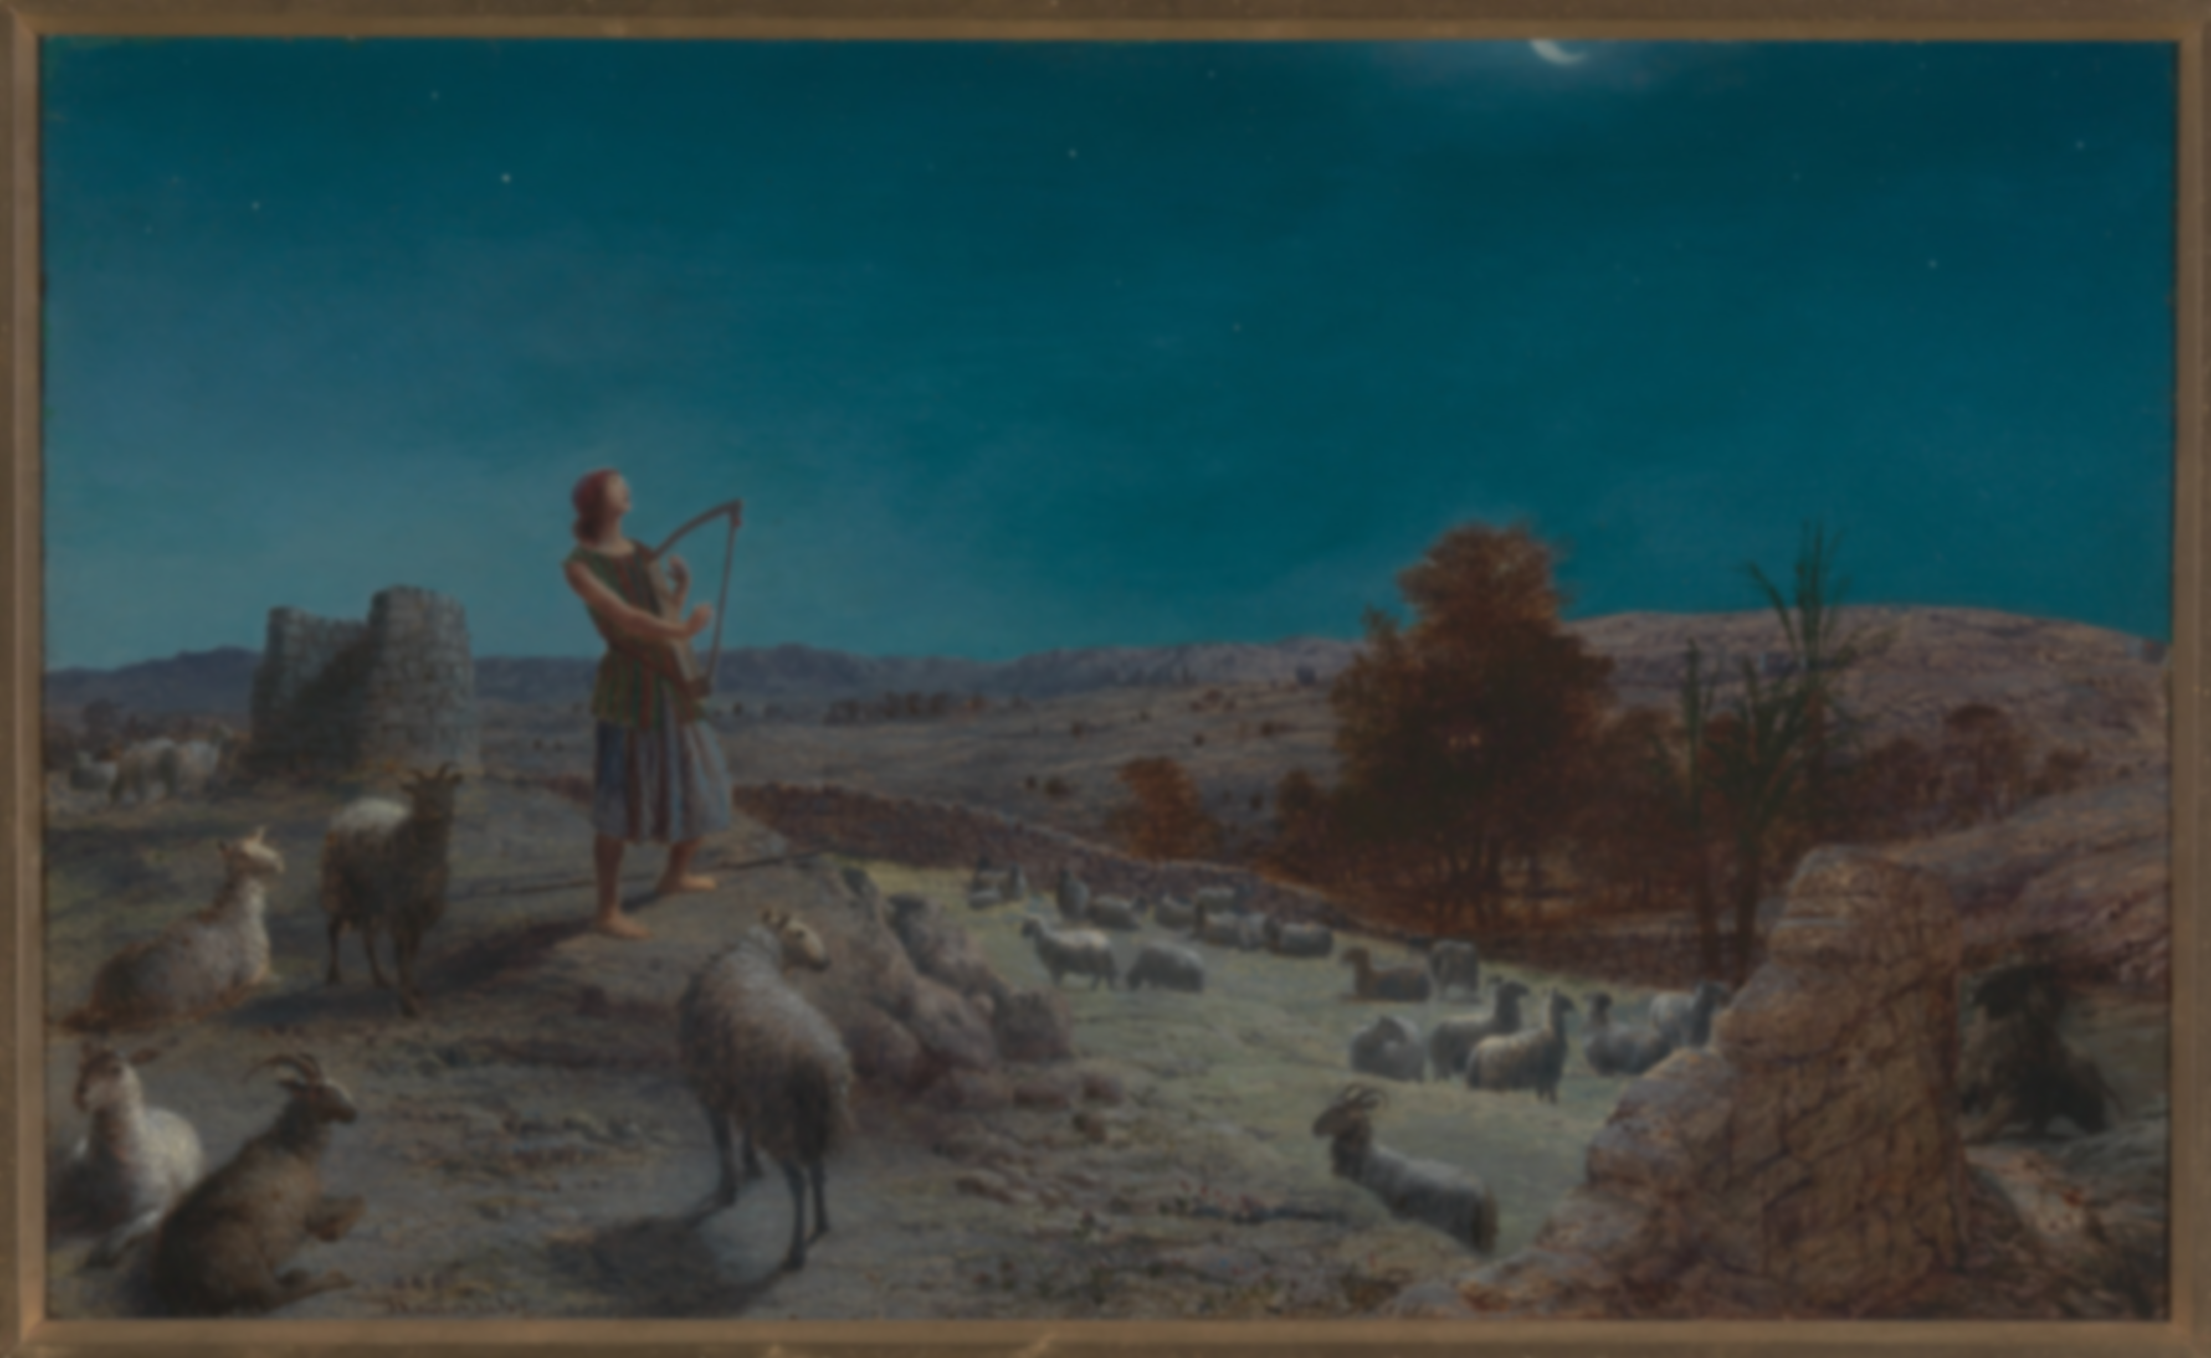
The Humble King

Slide 5
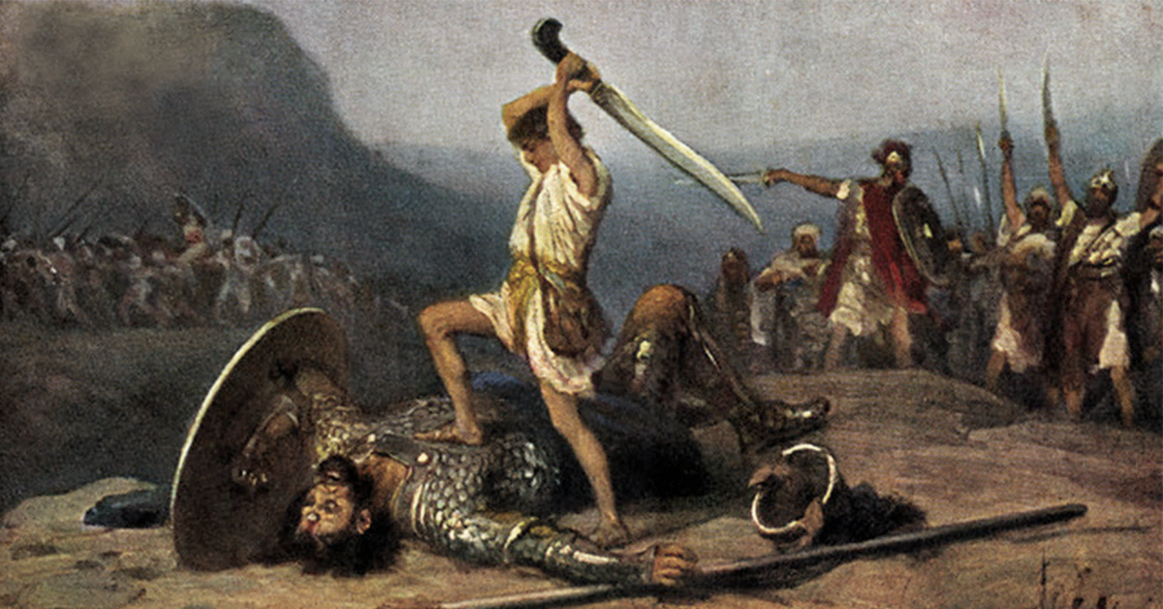
The Mighty God

Slide 6
The Devil is
In The Details
The Saviour Is In The Specifics

Slide 7

Our Mighty God
Defeats The Great Enemy Through His Humble King

Slide 8
As For the King
So For the Kingdom
We Share In His Victory
As We Share His Humility

Slide 9
Have Confidence in God Your King,
And Rejoice in His Reign

