Slide 1

1 Thessalonians
A Gospel Church | From First Till Last

Slide 2
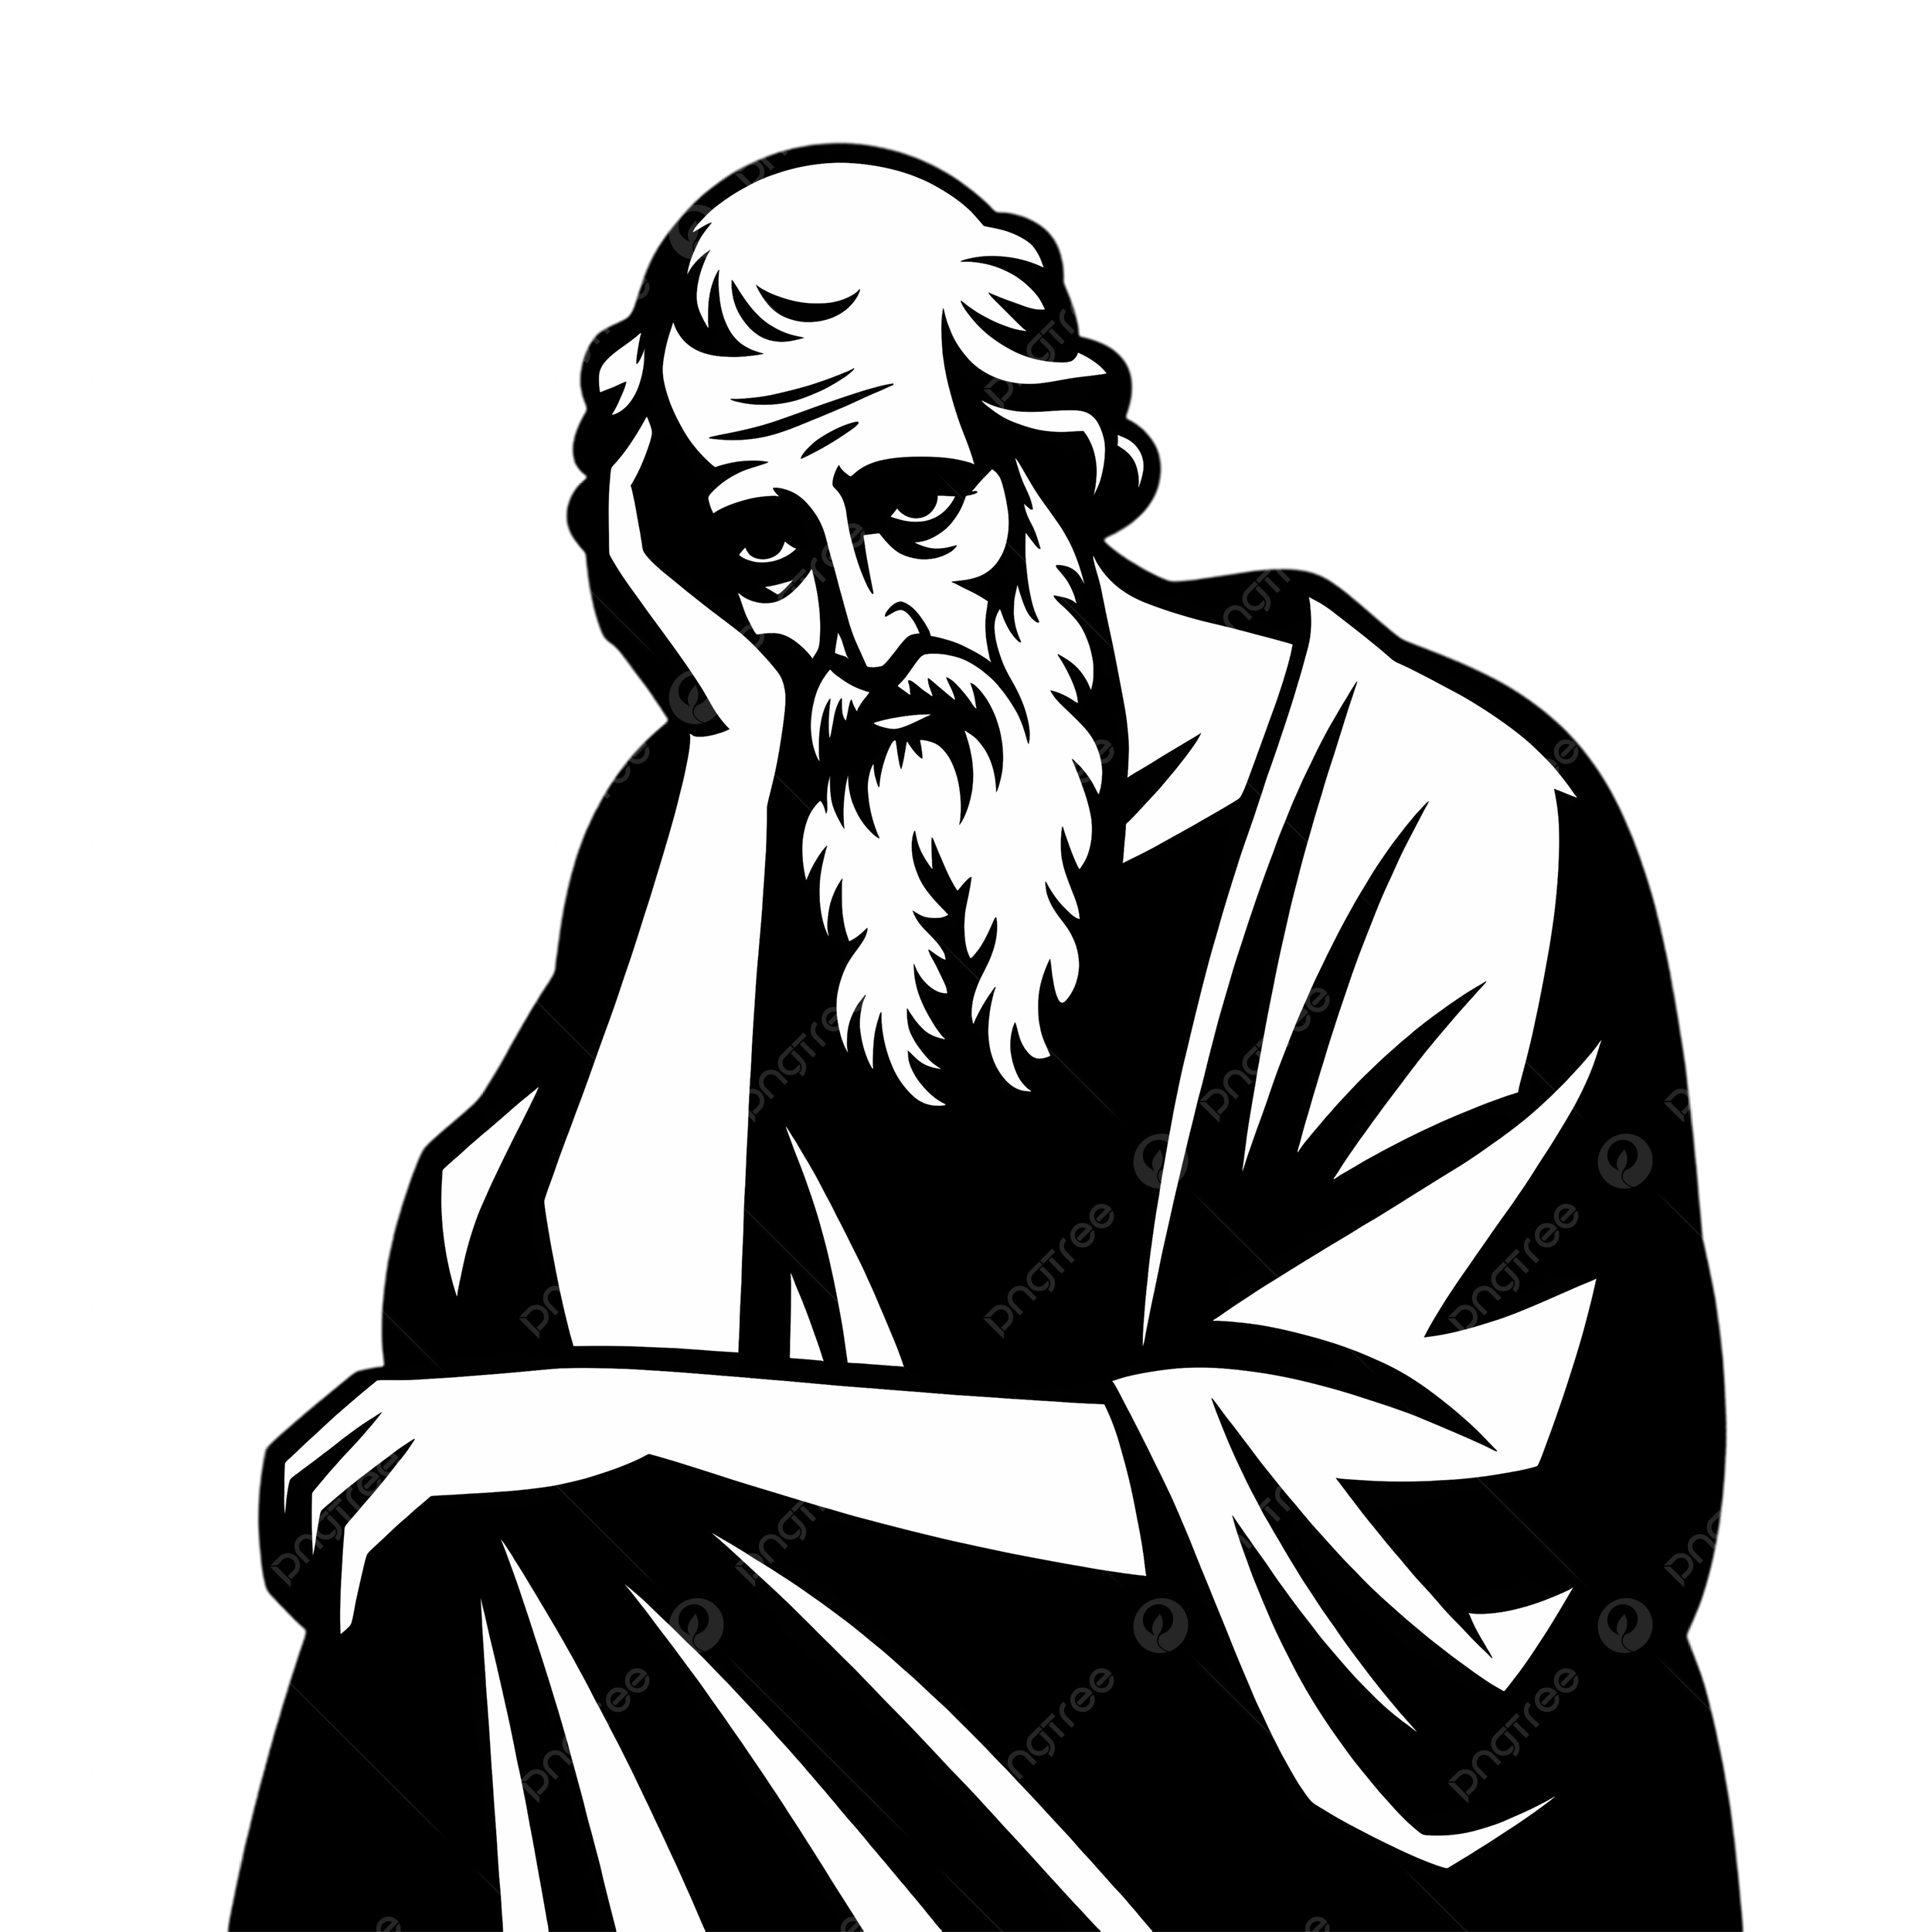
Example

Slide 3
A Custodian of God’s Gospel
A Carer For God’s Church
Page 1048
2.1-16

Slide 4

A Continuer Despite
God’s Enemies
Ministry Reality - Hostility from those
who Displease God
Page 1048
2.1-16

Slide 5
1 Thessalonians
1 Thessalonians
2:17-3:13 | Page 1046-7

Slide 6
When you Suffer
For the Gospel
Don’t Be Surprised
Don’t Stop
Do Strengthen and Take Strength From Each Other
Page 1048
2.17-3.13

Slide 7
As God Himself
Keeps You
Page 1048
2.17-3.13

