Slide 1
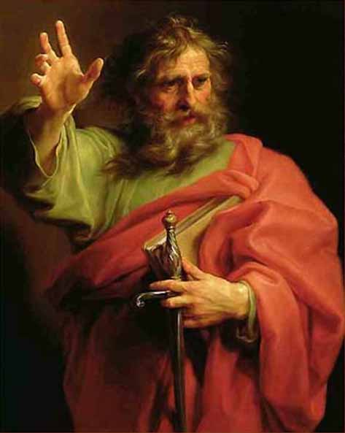
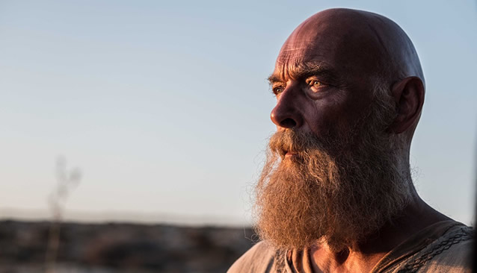
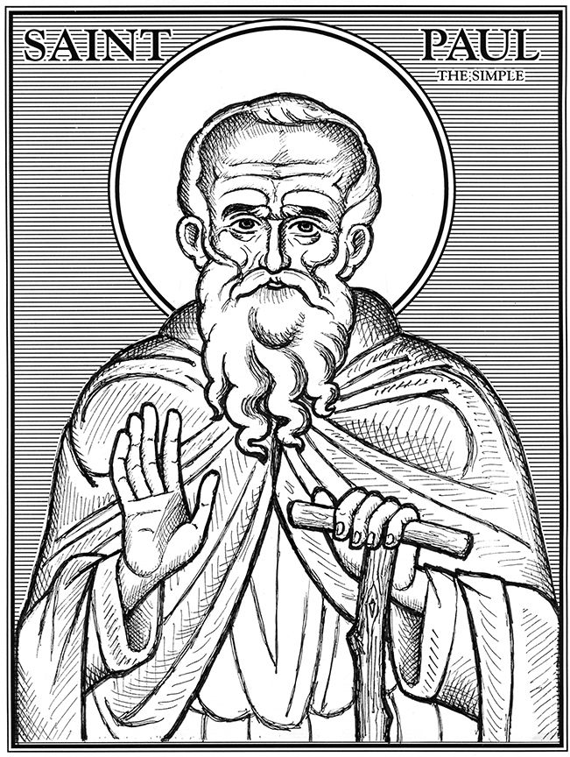
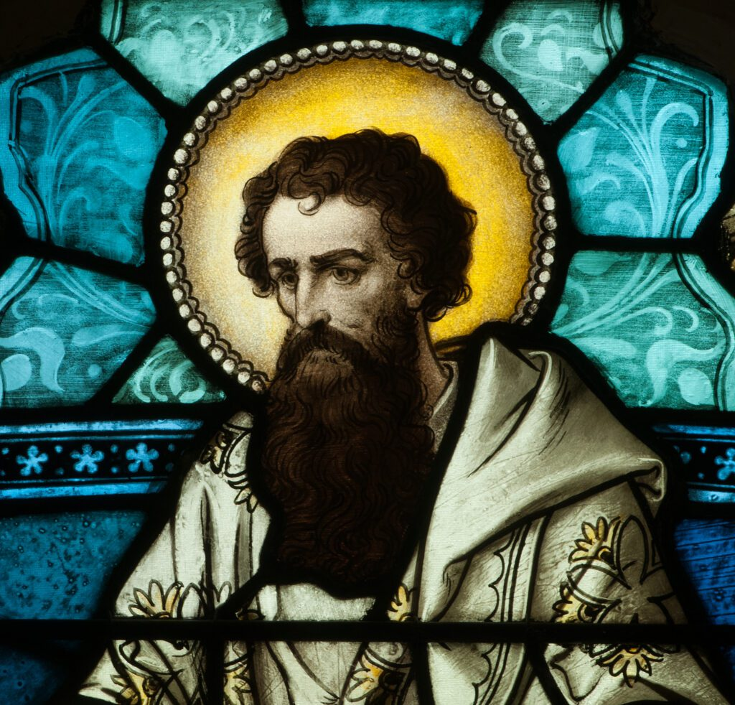
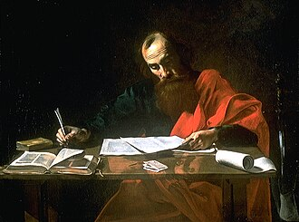
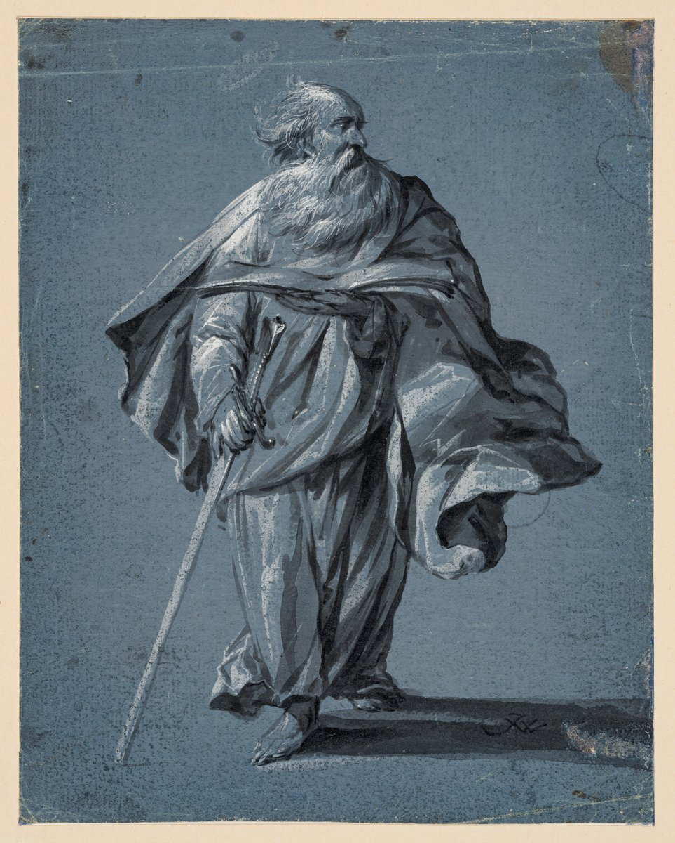

Slide 2

1 Thessalonians
1 Thessalonians
2:1-16 | Page 1046

Slide 3
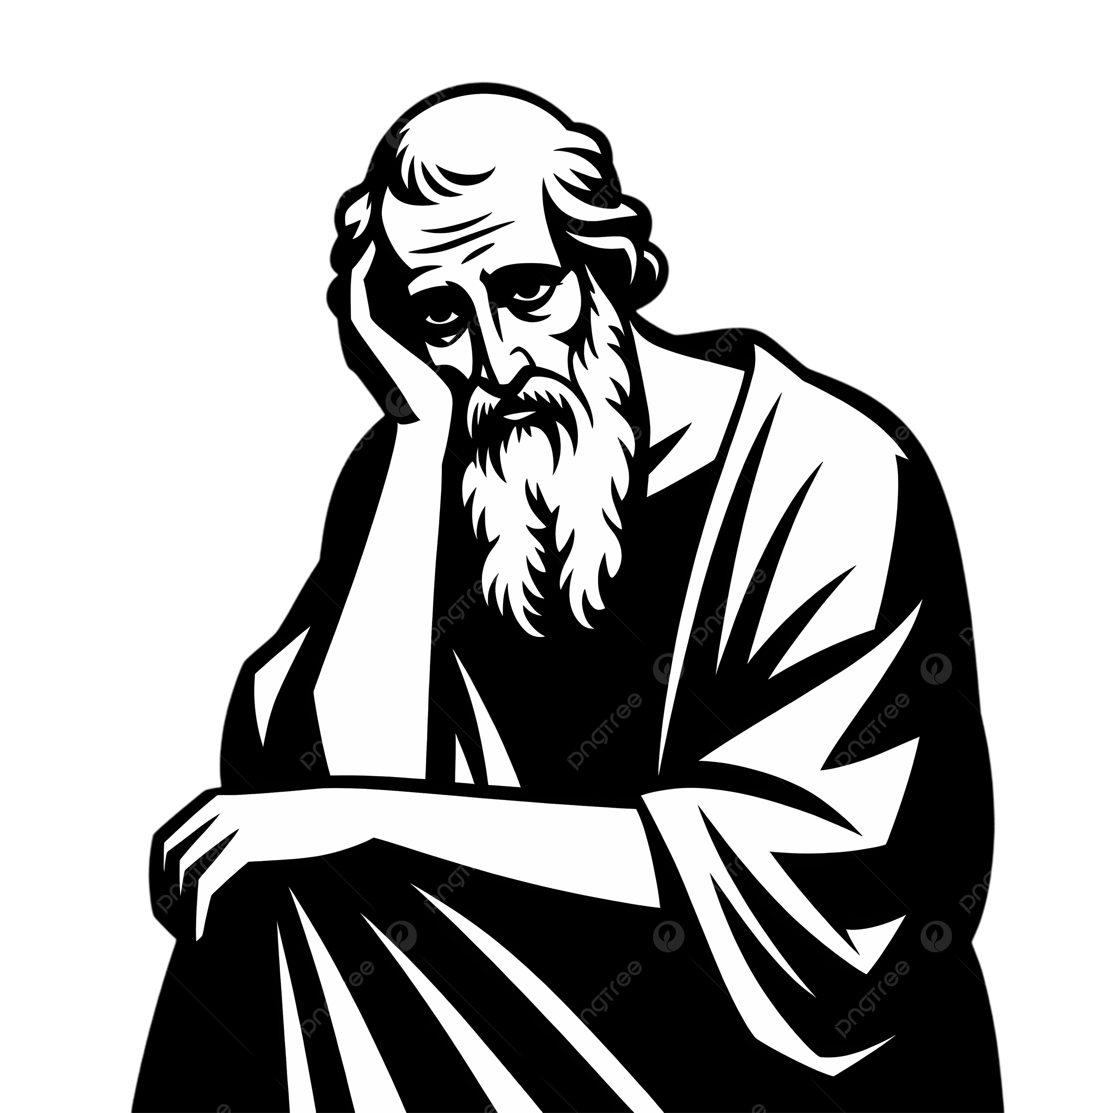

Why?
The Situation?
A
Leadership Lessons?
B
As an Example?
C

Slide 4
1 Thessalonians
A Gospel Church | From First Till Last

Slide 5
A Custodian of Gods Gospel
Preaching Goal - Pleasing God
Not Pleasing Himself
Or Pleasing Others
Page 1048
2.1-16

Slide 6
A Carer For Gods Church
Ministry Goal - Them Pleasing God
Ministry Model - Toil and Teaching
Ministry Manner - Gentle, Godly, Giving
Page 1048
2.1-16

Slide 7
A Continuer Despite
Gods Enemies
Ministry Reality - Hostility from those
who Displease God
Page 1048
2.1-16

Slide 8
1 Thessalonians
A Gospel Church | From First Till Last

