Slide 1
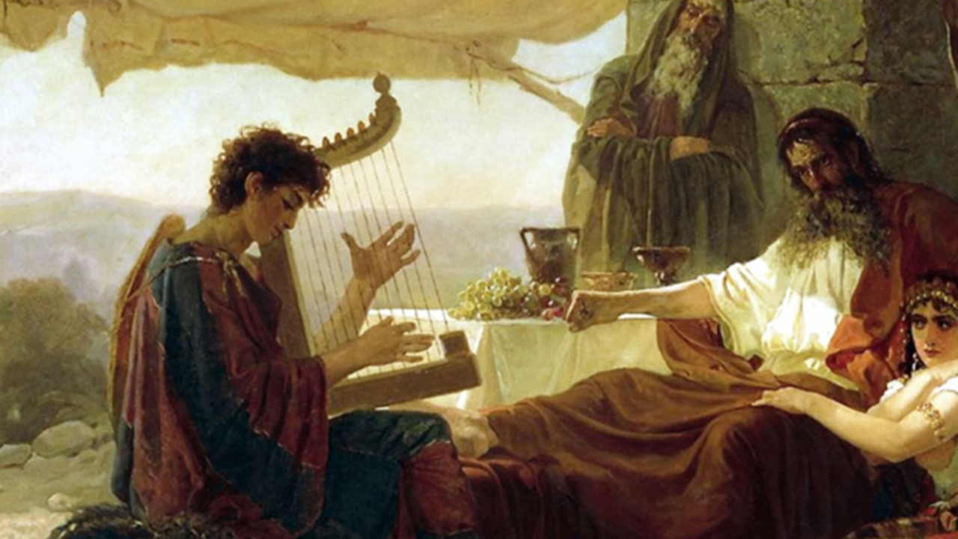
1 Samuel

Slide 2
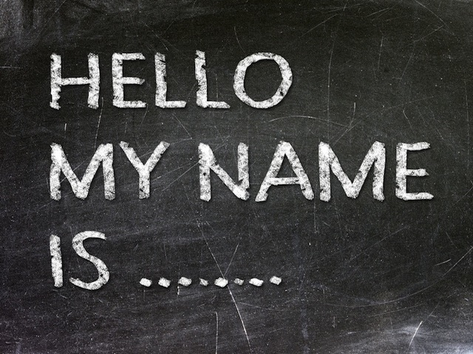

Slide 3
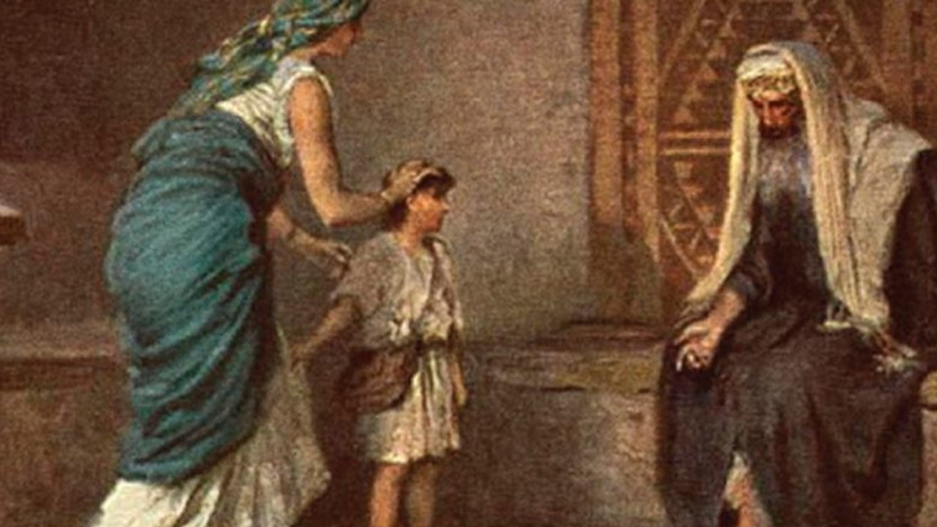

Slide 4
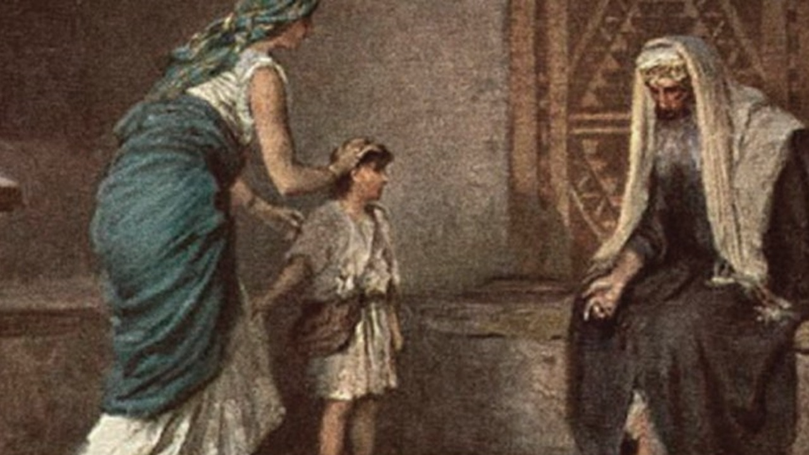
1 Samuel 3.1-4.1
Page 235-6

Slide 5
A Priestly
Rise and Fall
1 Samuel 3:1-4:1

Slide 6
Samuel Must Be
A Hearer
“ Speak Lord, Your Servant Is Listening”
1 Samuel 3:1-4:1

Slide 7
Samuel Must Be
A Herald
“ He Told Him Everything”
1 Samuel 3:1-4:1

Slide 8
Why?
God Makes Himself Known
Through His Word
1 Samuel 3:1-4:1

Slide 9
Why?
God Reigns As King Through Hearer/Heralds
Of His Word
1 Samuel 3:1-4:1

Slide 10
Jesus
The Word Made Flesh
1 Samuel 3:1-4:1

Slide 11
The Church
Needs Servants Who Hear and Herald The Word
1 Samuel 3:1-4:1

Slide 12
The Church
Must Serve By Hearing and Heralding Gods Word
1 Samuel 3:1-4:1

