Slide 1
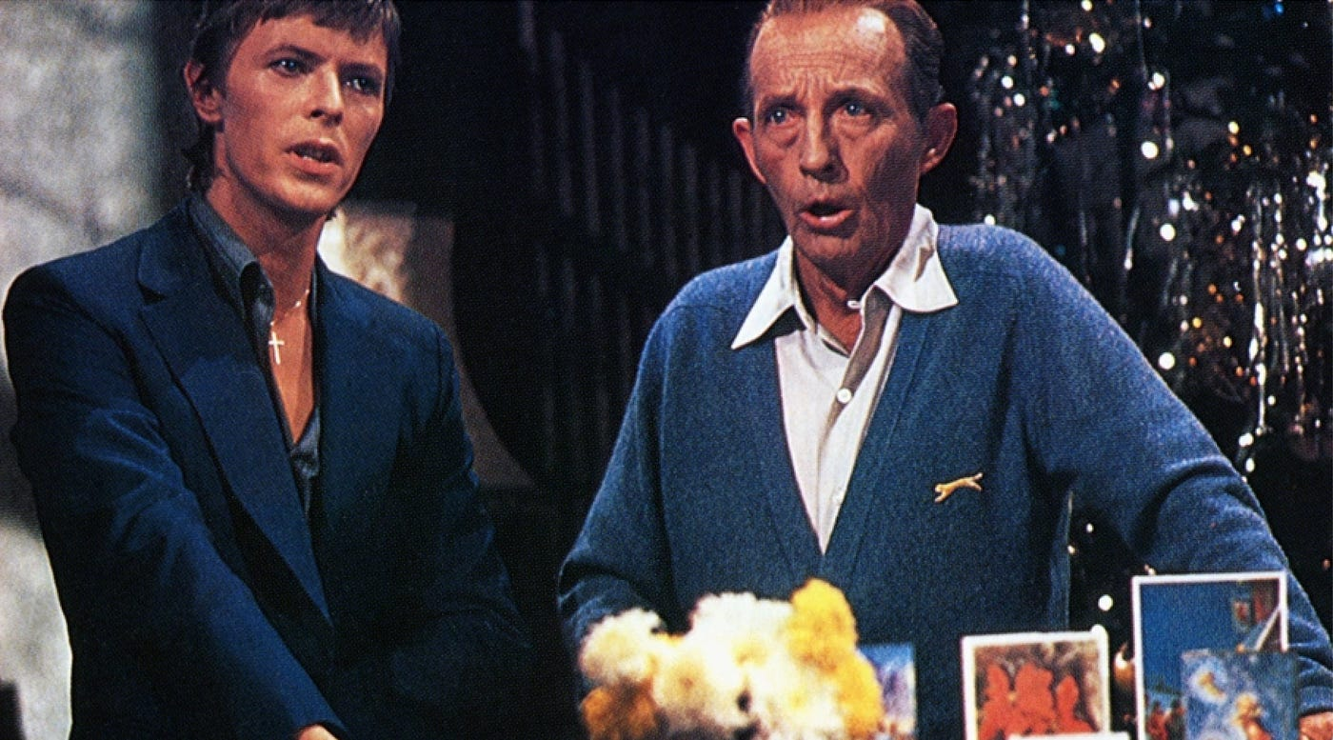

Slide 3
PHILIPPIANS
4:6-9
Page | 1042

Slide 4
Peace of God v7
God of Peace v9
4:6-9

Slide 5
PARNERS @ PEACE
PRAY | Pour Out Your Heart
PONDER | Fill Up Your Head
follow the PATTERN | Move Your Feet
4:6-9

