Slide 1

PHILIPPIANS
4:10-23
Page | 1042

Slide 2
Receive Supernaturally with Gospel Joy
Not From Need
Not From Greed
But From Supernatural Joy
4:10-23

Slide 3
“If I find in myself desires which nothing in this world can satisfy,
the only logical explanation is that I was made for another world.”
4:10-23

Slide 4
Give Supernaturally with Gospel Generosity
4:10-23

Slide 5
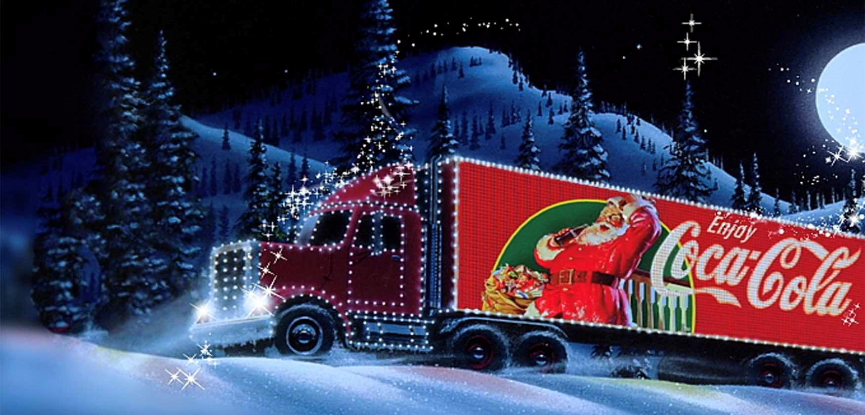

Slide 6


Slide 7
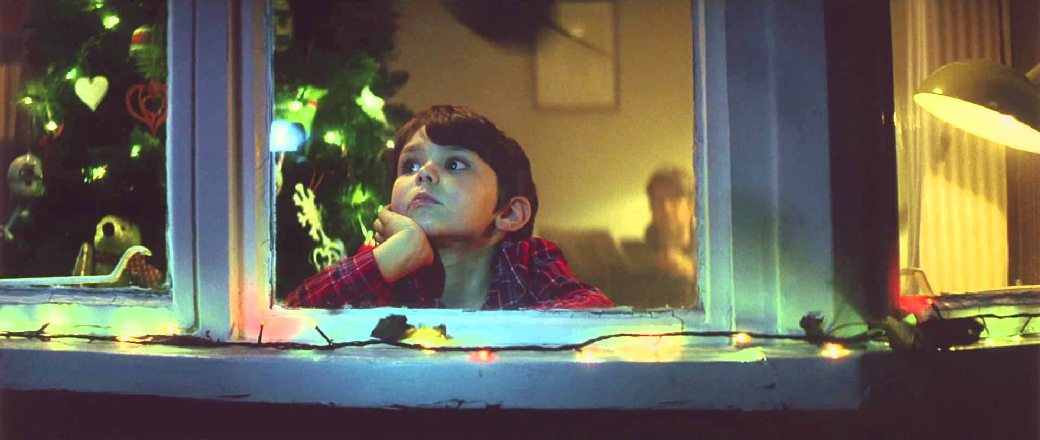

Slide 8
Give Supernaturally with Gospel Generosity
With The Affections of Christ
4:10-23

Slide 9
“During a severe trial brought about by affliction, their abundant joy and their extreme poverty overflowed in a wealth of generosity on their part. I can testify that, according to their ability and even beyond their ability, of their own accord, they begged us earnestly for the privilege of sharing in the ministry to the saints”
(2 Cor 8:2-5)

Slide 10
Give Supernaturally with Gospel Generosity
With The Affections of Christ
To The Pleasure of God
4:10-23

