Slide 2
KING

Slide 3
Mathew 2:2
“Where is he who has been born king of the Jews?

Slide 4
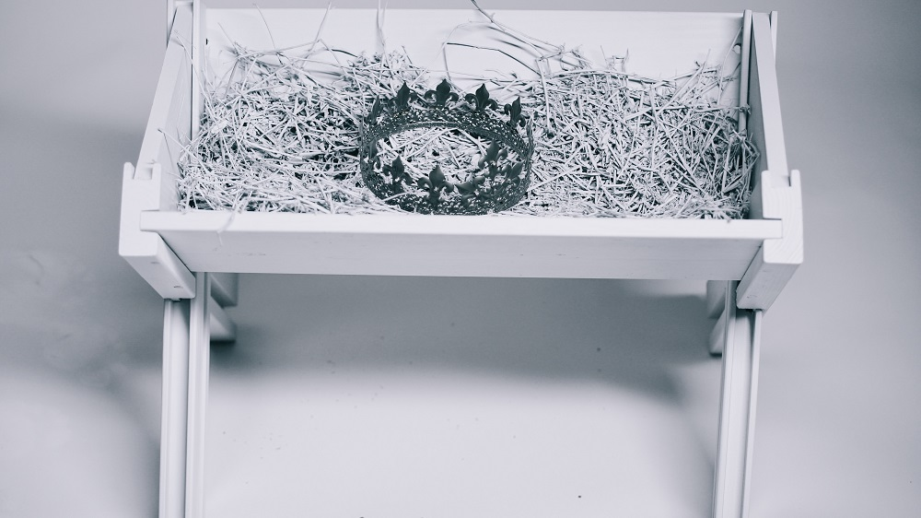

Slide 5
The King of Heaven
Come to Earth
The Promised King
Come to Save

Slide 6
Mathew 2:2
“Where is he who has been born king of the Jews? For we saw his star at its rising and have come to worship him.”

Slide 7
Mathew 2:4
So he assembled all the chief priests and scribes of the people and asked them where the Messiah would be born.

Slide 8
The King of Heaven
Come to Earth
The Promised King
Come to Save

Slide 9
This King is
Worthy of Worship

Slide 10
Mathew 2:2
“Where is he who has been born king of the Jews? For we saw his star at its rising and have come to worship him.”

Slide 11
Mathew 2:9-10
the star they had seen at its rising led them until it came and stopped above the place where the child was. 10 When they saw the star, they were overwhelmed with joy.

Slide 12
Mathew 2:11
Entering the house, they saw the child with Mary his mother, and falling to their knees, they worshiped him. Then they opened their treasures and presented him with gifts: gold, frankincense, and myrrh.

Slide 13
This King is
Worthy of Worship

Slide 14
Mathew 2:3
When King Herod heard this, he was deeply disturbed, and all Jerusalem with him.

Slide 15
This King Is King
And It Becomes Clear We’re Not

Slide 16
Mathew 2:19-20
After Herod died, an angel of the Lord appeared in a dream to Joseph in Egypt, saying, “Get up, take the child and his mother, and go to the land of Israel, because those who intended to kill the child are dead.”

Slide 17
This King Is King
And It Becomes Clear We’re Not

Slide 18
Come and Worship
The King

