Slide 2
Luke 2:10
Page #909

Slide 4
Luke 2:8-9
shepherds were staying out in the fields and keeping watch at night over their flock. Then an angel of the Lord stood before them, and the glory of the Lord shone around them, and they were terrified.

Slide 5
Luke 2:10
But the angel said to them, “Don’t be afraid, for look, I proclaim to you good news

Slide 6
Luke 2:11
Today in the city of David a Savior was born for you, who is the Messiah, the Lord.

Slide 7
Jesus is
“Good News”

Slide 8
Luke 2:11
Today in the city of David a Savior was born for you, who is the Messiah, the Lord.

Slide 9
Jesus is
“Good News”

Slide 10
Luke 2:10
10 But the angel said to them, “Don’t be afraid, for look, I proclaim to you good news of great joy

Slide 11
Jesus Brings
“Great Joy”

Slide 12
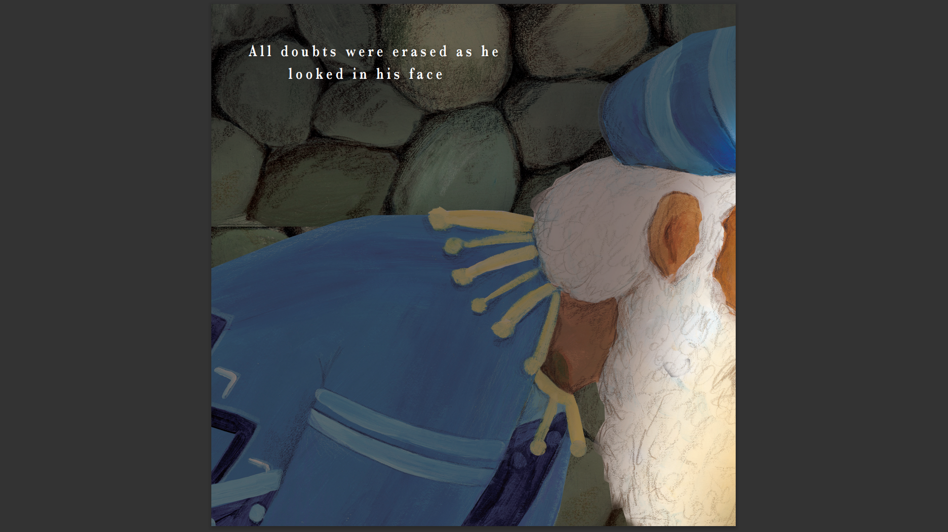
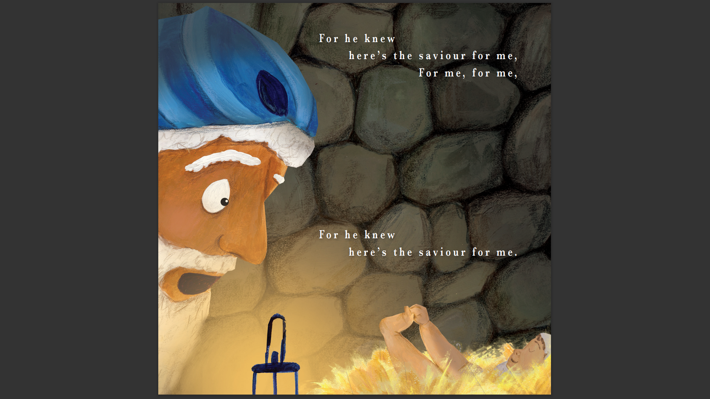

Slide 13
Jesus Brings
“Great Joy”

Slide 14
Luke 2:10
10 But the angel said to them, “Don’t be afraid, for look, I proclaim to you good news of great joy that will be for all the people:

Slide 15
Jesus Is For
“All People”

Slide 18
Jesus Is For
“All People”

Slide 19
Jesus Is “Good News”,
He Brings Great Joy”
And He’s For “All People”

Slide 20
Hurry To Find Out
About Jesus

Slide 21
15 When the angels had left them and returned to heaven, the shepherds said to one another,“Let’s go straight to Bethlehem and see what has happened, which the Lord has made known to us.”
16 They hurried off and found both Mary and Joseph, and the baby who was lying in the manger

Slide 22
Hurry To Find Out
About Jesus

Slide 23
Joyfully Praise God
For Jesus

Slide 24
Luke 2:20
The shepherds returned, glorifying and praising God for all the things they had seen and heard, which were just as they had been told.

Slide 25
Joyfully Praise God
For Jesus

Slide 26
Go Tell Others
About Jesus

Slide 27
Luke 2:17-18
After seeing them, they reported the message they were told about this child, and all who heard it were amazed at what the shepherds said to them.

Slide 28
Go Tell Others
About Jesus

Slide 29
Jesus Is “Good News”,
He Brings Great Joy”
And He’s For “All People”

